Slide 1
Risk Management & Banks Analytics & Information Requirement
By
A.K.Nag

Slide 2
To-day’s Agenda
Risk Management and Basel II- an overview
Analytics of Risk Management
Information Requirement and the need for building a Risk Warehouse
Roadmap for Building a Risk Warehouse

Slide 3
In the future . . .
Intelligent management of risk will be the foundation of a successful financial institution

Slide 4
Concept of Risk
Statistical Concept
Financial concept

Slide 5
Statistical Concept
We have data x from a sample space Χ.
Model- set of all possible pdf of Χ indexed by θ.
Observe x then decide about θ. So have a decision rule.
Loss function L(θ,a): for each action a in A.
A decision rule-for each x what action a.
A decision rule δ(x)- the risk function is defined as R(θ, δ) =E_{θ}L(θ, δ(x)).
For a given θ, what is the average loss that will be incurred if the decision rule δ(x) is used

Slide 6
Statistical Concept- contd.
We want a decision rule that has a small expected loss
If we have a prior defined over the parameter space of θ , say Π(θ) then Bayes risk is defined as B(Π, δ)=E_{Π}(R(θ, δ))

Slide 7
Financial Concept
We are concerned with L(θ,a). For a given financial asset /portfolio what is the amount we are likely to loose over a time horizon with what probability.

Slide 8
Types of Financial Risks
Risk is multidimensional
Market Risk
Financial
Risks
Credit Risk
Operational Risk
Notes:
The key financial risks that we must address can be broken up into:
Market
Credit
Liquidity
Operational
Regulatory Risk
Human Factor Risk
These risks are meant to be neither mutually exclusive nor exhaustive. We can further divide each one of these risks into its subcomponents. For example, market risk can be broken up into
equity
interest rate
currency
and
commodity
And likewise interest rate risk can be further divided into “Trading” and “Gap” risks.
The risk picture is then depicted on this slide. Let’s now explore credit risk in more detail.

Slide 9
Hierarchy of Financial Risks
“Specific
Risk”
Equity Risk
Trading Risk
Market Risk
General
Market
Risk
Interest Rate Risk
Financial
Risks
Gap Risk
Credit Risk
Currency Risk
Commodity Risk
Counterparty
Risk
Operational
Risk
Transaction Risk
Issuer Risk
Portfolio
Concentration
Risk
Issue Risk
* From Chapter-1, “Risk Management” by Crouhy, Galai and Mark
Notes:
The key financial risks that we must address can be broken up into:
Market
Credit
Liquidity
Operational
Regulatory Risk
Human Factor Risk
These risks are meant to be neither mutually exclusive nor exhaustive. We can further divide each one of these risks into its subcomponents. For example, market risk can be broken up into
equity
interest rate
currency
and
commodity
And likewise interest rate risk can be further divided into “Trading” and “Gap” risks.
The risk picture is then depicted on this slide. Let’s now explore credit risk in more detail.

Slide 10
Response to Financial Risk
Market response-introduce new products
  Equity futures
  Foreign currency futures
  Currency swaps
  Options
Regulatory response
  Prudential norms
  Stringent Provisioning norms
  Corporate governance norms

Slide 11
Evolution of Regulatory environment
G-3- recommendation in 1993
  20 best practice price risk management recommendations for dealers and end-users of derivatives
  Four recommendations for legislators, regulators and supervisors
1988 BIS Accord
  1996 ammendment
BASELII

Slide 12
BASEL-I
Two minimum standards
  Asset to capital multiple
  Risk based capital ratio (Cooke ratio)
Scope is limited
  Portfolio effects missing- a well diversified portfolio is much less likely to suffer massive credit losses
  Netting is absent
No market or operational risk

Slide 13
BASEL-I contd..
Calculate risk weighted assets for on-balance sheet items
Assets are classified into categories
Risk-capital weights are given for each category of assets
Asset value is multiplied by weights
Off-balance sheet items are expressed as credit equivalents

Slide 14

The New Basel Capital Accord
Three Basic Pillars
Minimum Capital Requirement
Supervisory
Review Process
Market
Discipline
Requirements
Notes:
The new capital accord would consist of thre basic pillars. Taken together they are seen as essential to the working of an effective regulatory capital framework
1) A minimum capital requirement, which seeks to expand on and develop the concept of standardized rules to calculate a minimum level of capital for any institution.
2) A Supervisory review of an institution’s capital adequacy and internal assessment process. This will seek to ensure that the regulators are comfortable that a bank’s capital position is consistent with its overall risk profile and strategy. Early intervention is envisaged, if a regulator deems there to be deficiencies in either the level of capital or the internal control mechanisms.
3) A Market Discipline pillar, which will act as a lever to strengthen disclosure and encourage safe and sound banking practices. Effective market discipline requires the disclosure of reliable and timely information, so that market participants and creditors can make well founded risk assessments. A significant intention, here, being to lessen the risk of “Moral hazard” to the local regulator. In th past regulators have often felt compelled to bail out creditors who have claimed that a lack of information and discolors prevented them from understanding the risks they were taking.

Slide 15
Minimum Capital Requirement
Pillar One
Standardized
Internal Ratings
Credit Risk Models
Credit Mitigation
Credit Risk
Trading Book
Banking Book
Risks
Market Risk
Operational
Other
Other Risks

Slide 16
Workhorse of Stochastic Process
Markov Process
Weiner process (dz)
  Change δz during a small time period(δt) is δz=ε√(δt)
  Δz for two different short intervals are independent
Generalized Wiener process
  dx=adt+bdz
Ito process
  dx=a(x,t)+b(x,t)dz
Ito’s lemma
  dG=(∂G/∂x*a+∂G/∂t+1/2*∂²G/∂²x²*b²⁾ dt ⁺∂G/∂x*b*dz

Slide 17
Credit Risk

Slide 18
Minimum Capital Requirements- Credit Risk (Pillar One)
Standardized approach
(External Ratings)
Internal ratings-based approach
    Foundation approach
    Advanced approach
Credit risk modeling
(Sophisticated banks in the future)
Minimum Capital Requirement

Slide 19
Evolutionary Structure of the Accord
Credit Risk Modeling ?
Advanced IRB Approach
Foundation IRB Approach
Standardized Approach
Increased level of sophistication

Slide 20
The New Basel Capital Accord
Standardized Approach
Provides Greater Risk Differentiation than 1988
Risk Weights based on external ratings
Five categories [0%, 20%, 50%, 100%, 150%]
Certain Reductions
  e.g. short term bank obligations
Certain Increases
  e.g.150% category for lowest rated obligors

Slide 21
Standardized Approach
Based on assessment of external credit assessment institutions
External Credit Assessments
Sovereigns
Banks/Securities Firms
Corporates
Public-Sector Entities
Asset Securitization Programs

Slide 22
Standardized Approach:
New Risk Weights (June 1999)
Assessment
Claim
AAA to
A+ to A-
BBB+ to
BB+ to
Below B-
Unrated
AA-
BBB-
B-
Sovereigns
0%
20%
50%
100%
150%
100%
Option 1¹
20%
50%
100%
100%
150%
100%
Banks
Option 2²
20%
50%
3
50%
3
100%
3
150%
50%
3
Corporates
20%
100%
100%
100%
150%
100%
¹ Risk weighting based on risk weighting of sovereign in which the bank is incorporated.
² Risk weighting based on the assessment of the individual bank.
³ Claims on banks of a short original maturity, for example less than six months, would receive a weighting that is one category more favourable than the usual risk weight on the bank’s claims
.

Slide 23
Standardized Approach:
New Risk Weights (January 2001)
Assessment
Claim
AAA to
A+ to A-
BBB+ to
BB+ to
Below BB-
(B-)
Unrated
AA-
BBB-
BB- (B-)
Sovereigns
0%
20%
50%
100%
150%
100%
Option 1¹
20%
50%
100%
100%
150%
100%
Banks
Option 2²
20%
50%
3
3
100%
3
150%
50%
3
50%
Corporates
20%
50%(100%)
100%
100%
150%
100%
¹ Risk weighting based on risk weighting of sovereign in which the bank is incorporated.
² Risk weighting based on the assessment of the individual bank.
³ Claims on banks of a short original maturity, for example less than six months, would receive a weighting that is one category more favourable than the usual risk weight on the bank’s claims
.

Slide 24
Internal Ratings-Based Approach
Two-tier ratings system:
  Obligor rating
    represents probability of default by a borrower
  Facility rating
    represents expected loss of principal and/or interest
Pillar 1
Notes:
We suggest adopting a two-tier rating system.
First an obligor rating that can be easily mapped to a default probability bucket .
Second, a facility rating that determines the loss parameters in case of default, such as (I) loss given default (LGD) which depends on the seniority of the facility and the quality of the guarantees, and (ii) usage given default (UGD) for loan commitments which depends on the nature of the commitment and the rating history of the borrower.

Slide 25
Opportunities for a
Regulatory Capital Advantage
Example: 30 year Corporate Bond
Standardized
Model
Internal
Model
Capital
Market
Credit
98 Rules
Notes:
Internal Models also provide opportunities for a regulatory capital advantage.
For example, let’s consider an actual AA long-term corporate bond.
Our internal models reveal that we require less regulatory capital for investment grade bonds in the trading book then the 98 standardized rules CLICK as well as the old 88 rules. Conversely, we require more regulatory capital for non investment grade bonds than the 98 standardized rule as well as the old 88 rules.

Slide 26
Standardized Approach
Internal rating system & Credit VaR
New standardized model
16
12
PER CENT
8
1.6
0
S & P :
AAA
AA
A+
A-
BBB
BB+
BB-
B
CCC
1
2
3
4
4.5
5
5.5
6
6.5
7
RATING
Notes:
This graph shows regulatory capital for various classes of obligors in a well diversified portfolio. The checkered panels represent capital under the new proposal, while the bar chart is the capital for obligors rated 1 to 7 according to CIBC’s internal rating system. The difference between the two is huge.
The new accord penalizes heavily holdings from investment grade borrowers. Conversely, the new accord doesn’t allocate enough capital for speculative grade borrowers rated B and below, as well as the toxic waste CCC and below.

Slide 27
Internal Model- Advantages
Example: Portfolio of
100 $1 bonds
diversified across industries
Capital charge for specific risk (%)
Internal
model
Standardized
approach
AAA
0.26
1.6
AA
0.77
1.6
A
1.00
1.6
BBB
2.40
1.6
BB
5.24
8
B
8.45
8
CCC
10.26
8

Slide 28
Internal Ratings-Based Approach
Three elements:
  Risk Components [PD, LGD, EAD]
  Risk Weight conversion function
  Minimum requirements for the management of policy
  and processes
  Emphasis on full compliance
Definitions;
PD = Probability of default [“conservative view of long run average (pooled) for borrowers assigned to a RR grade.”]
LGD = Loss given default
EAD = Exposure at default
Note: BIS is Proposing 75% for unused commitments
EL = Expected Loss

Slide 29
Internal Ratings-Based Approach
Risk Components
  Foundation Approach
    PD set by Bank
    LGD, EAD set by Regulator
      50% LGD for Senior Unsecured
      Will be reduced by collateral (Financial or Physical)
  Advanced Approach
    PD, LGD, EAD all set by Bank
    Between 2004 and 2006: floor for advanced
    approach @ 90% of foundation approach
Notes
Consideration is being given to incorporate maturity explicitly into the “Advanced”approach
Granularity adjustment will be made. [not correlation, not models]
Will not recognize industry, geography.
Based on distribution of exposures by RR.
Adjustment will increase or reduce capital based on comparison to a reference portfolio
[different for foundation vs. advanced.]

Slide 30
Expected Loss Can Be Broken Down Into Three Components
Borrower Risk
Facility Risk Related
EXPECTED LOSS
Rs.
Probability of Default
(PD)
%
Loss Severity
Given Default
(Severity)
%
Loan Equivalent
Exposure
(Exposure)
Rs
=
x
x
What is the probability of the counterparty defaulting?
If default occurs, how much of this do we expect to lose?
If default occurs, how much exposure do we expect to have?
The focus of grading tools is on modeling PD

Slide 31
Credit or Counter-party Risk
Credit risk arises when the counter-party to a financial contract is unable or unwilling to honour its obligation. It may take following forms
  Lending risk- borrower fails to repay interest/principal. But more generally it may arise when the credit quality of a borrower deteriorates leading to a reduction in the market value of the loan.
  Issuer credit risk- arises when issuer of a debt or equity security defaults or become insolvent. Market value of a security may decline with the deterioration of credit quality of issuers.
  Counter party risk- in trading scenario
  Settlement risk- when there is a ‘one-sided-trade’

Slide 32
Credit Risk Measures
Credit risk is derived from the probability distribution of economic loss due to credit events, measured over some time horizon, for some large set of borrowers. Two properties of the probability distribution of economic loss are important; the expected credit loss and the unexpected credit loss. The latter is the difference between the potential loss at some high confidence level and expected credit loss. A firm should earn enough from customer spreads to cover the cost of credit. The cost of credit is defined as the sum of the expected loss plus the cost of economic capital defined as equal to unexpected loss.

Slide 33
Contingent claim approach
Default occurs when the value of a company’s asset falls below the value of outstanding debt
Probability of default is determined by the dynamics of assets.
Position of the shareholders can be described as having call option on the firm’s asset with a strike price equal to the value of the outstanding debt. The economic value of default is presented as a put option on the value of the firm’s assets.

Slide 34
Assumptions in contingent claim approach
The risk-free interest rate is constant
The firm is in default if the value of its assets falls below the value of debt.
The default can occur only at the maturity time of the bond
The payouts in case of bankruptcy follow strict absolute priority

Slide 35
Shortcoming of Contingent claim approach
A risk-neutral world is assumed
Prior default experience suggests that a firm defaults long before its assets fall below the value of debt. This is one reason why the analytically calculated credit spreads are much smaller than actual spreads from observed market prices.

Slide 36
KMV Approach
KMV derives the actual individual probability of default for each obligor , which in KMV terminology is then called expected default frequency or EDF.
Three steps
  Estimation of the market value and the volatility of the firm’s assets
  Calculation of the distance-to-default (DD) which is an index measure of default risk
  Translation of the DD into actual probability of default using a default database.
Notes:
K-Stephen Kealhofer; M-John McQuown; V-Oldrich Vasiceck

Slide 37
An Actuarial Model: CreditRisk+
The derivation of the default loss distribution in this model comprises the following steps
  Modeling the frequencies of default for the portfolio
  Modeling the severities in the case of default
  Linking these distributions together to obtain the default loss distribution

Slide 38
The CreditMetrics Model
Step1 – Specify the transition matrix
Step2-Specify the credit risk horizon
Step3-Specify the forward pricing model
Step4 – Derive the forward distribution of the changes in portfolio value

Slide 39
IVaR and DVaR
IVaR-incremental vaR -it measures the incremental impact on the overall VaR of the portfolio of adding or eliminating an asset
  I is positive when the asset is positively correlated with the rest of the portfolio and thus add to the overall risk
  It can be negative if the asset is used as a hedge against existing risks in the portfolio
DeltaVaR(DVaR) - it decomposes the overall risk to its constituent assets’s contribution to overall risk

Slide 40
Information from Bond Prices
Traders regularly estimate the zero curves for bonds with different credit ratings
This allows them to estimate probabilities of default in a risk-neutral world

Slide 41
Typical Pattern
(See Figure 26.1, page 611)
Baa/BBB
Spread over Treasuries
A/A
Aa/AA
Aaa/AAA
Maturity

Slide 42
The Risk-Free Rate
Most analysts use the LIBOR rate as the risk-free rate
The excess of the value of a risk-free bond over a similar corporate bond equals the present value of the cost of defaults

Slide 43
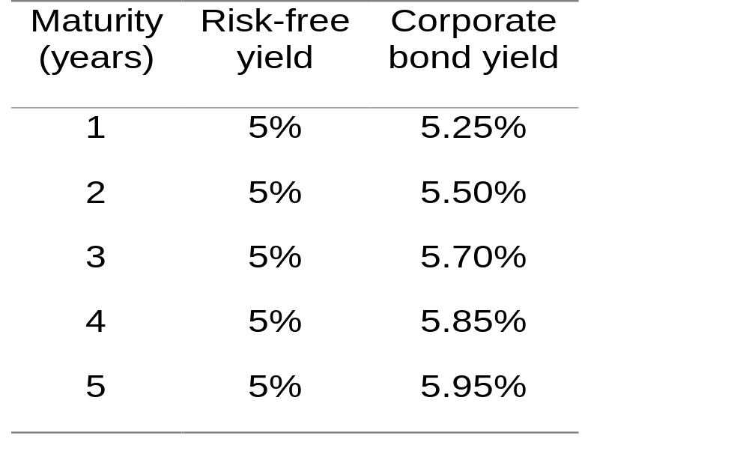
Example (Zero coupon rates; continuously compounded)

Slide 44


Example continued
One-year risk-free bond (principal=1) sells for
One-year corporate bond (principal=1) sells for
or at a 0.2497% discount
This indicates that the holder of the corporate bond expects to lose 0.2497% from defaults in the first year

Slide 45
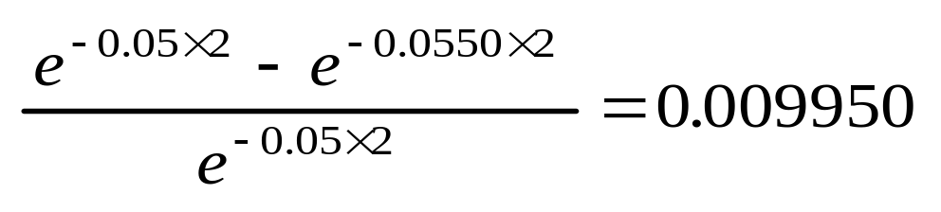
Example continued
Similarly the holder of the corporate bond expects to lose
or 0.9950% in the first two years
Between years one and two the expected loss is 0.7453%

Slide 46
Example continued
Similarly the bond holder expects to lose 2.0781% in the first three years; 3.3428% in the first four years; 4.6390% in the first five years
The expected losses per year in successive years are 0.2497%, 0.7453%, 1.0831%, 1.2647%, and 1.2962%

Slide 47
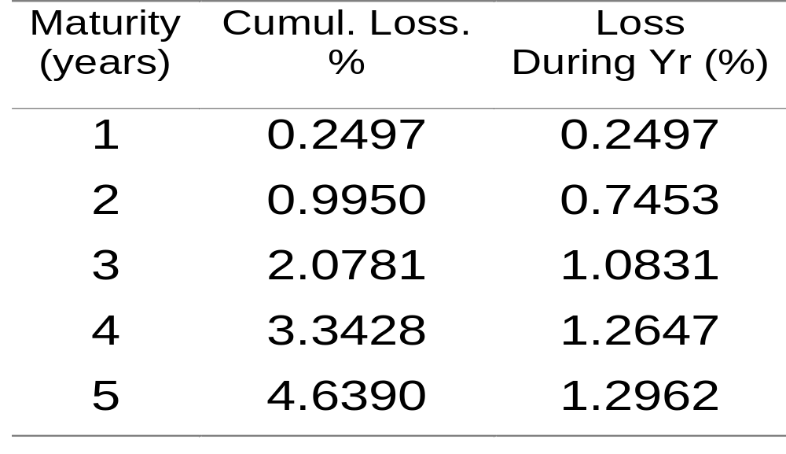
Summary of Results
(Table 26.1, page 612)

Slide 48
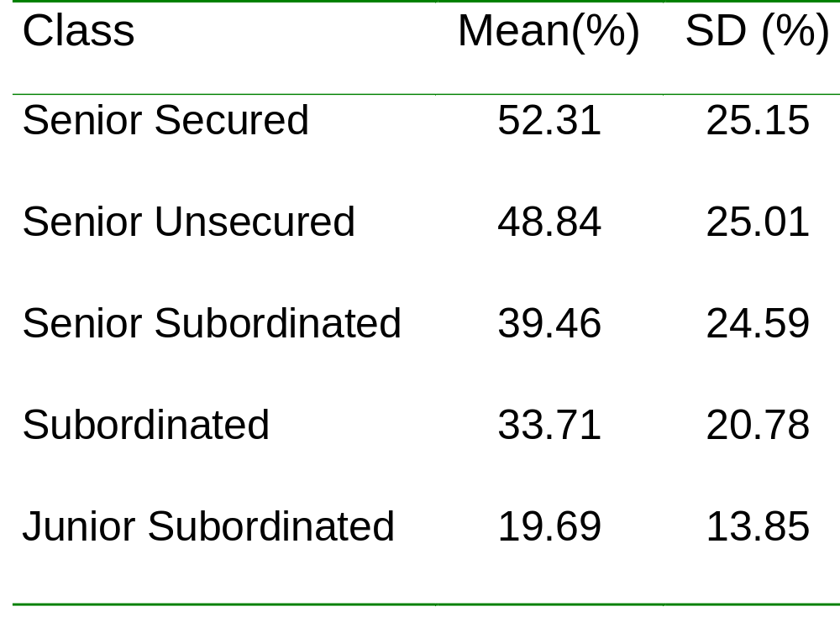
Recovery Rates
(Table 26.3, page 614. Source: Moody’s Investor’s Service, 2000)

Slide 49
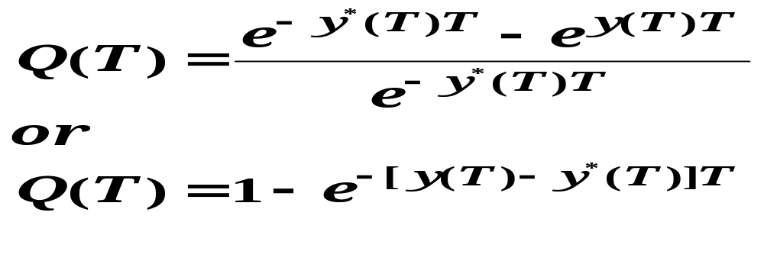
Probability of Default Assuming No Recovery
Where y(T): yield on a T-year corporate zero-coupon bond
Y*(T): Yield on a T-year risk –free zero coupon bond
Q(T): Probability that a corporation would default between time zero and T

Slide 50
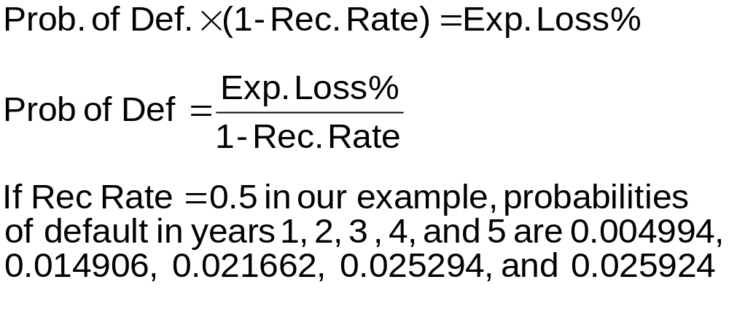
Probability of Default

Slide 51
Large corporates and specialised lending
  Characteristics of these sectors
  Relatively large exposures to individual obligors
  Qualitative factors can account for more than 50% of the risk of obligors
  Scarce number of defaulting companies
  Limited historical track record from many banks in some sectors
  Statistical models are NOT applicable in these sectors:
  Models can severely underestimate the credit risk profile of obligors given the low proportion of historical defaults in the sectors.
  Statistical models fail to include and ponder qualitative factors.
  Models’ results can be highly volatile and with low predictive power.

Slide 52
To build an internal rating system for Basel II you need:
Consistent rating methodology across asset classes
Use an expected loss framework
Data to calibrate Pd and LGD inputs
Logical and transparent workflow desk-top application
Appropriate back-testing and validation.

Slide 53
Six Organizational Principles for Implementing IRB Approach
All credit exposures have to be rated.
The credit rating process needs to be segregated from the loan approval process
The rating of the customer should be the sole determinant of all relationship management and administration related activities.
The rating system must be properly calibrated and validated
Allowance for loan losses and capital adequacy should be linked with the respective credit rating
The rating should recognize the effect of credit risk mitigation techniques

Slide 54
Credit Default Correlation
The credit default correlation between two companies is a measure of their tendency to default at about the same time
Default correlation is important in risk management when analyzing the benefits of credit risk diversification
It is also important in the valuation of some credit derivatives

Slide 55
Measure 1
One commonly used default correlation measure is the correlation between
  A variable that equals 1 if company A defaults between time 0 and time T and zero otherwise
  A variable that equals 1 if company B defaults between time 0 and time T and zero otherwise
The value of this measure depends on T. Usually it increases at T increases.

Slide 56
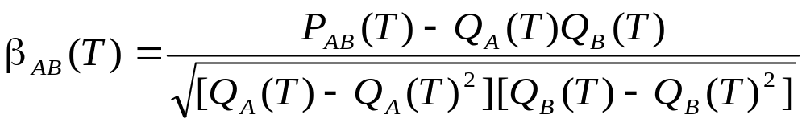
Measure 1 continued
Denote Q_{A}(T) as the probability that company A will default between time zero and time T, Q_{B}(T) as the probability that company B will default between time zero and time T, and P_{AB}(T) as the probability that both A and B will default. The default correlation measure is

Slide 57
Measure 2
Based on a Gaussian copula model for time to default.
Define t_{A} and t_{B} as the times to default of A and B
The correlation measure, ρ_{AB} , is the correlation between
u_{A}(t_{A})=N⁻¹[Q_{A}(t_{A})]
and
u_{B}(t_{B})=N⁻¹[Q_{B}(t_{B})]
where N is the cumulative normal distribution function

Slide 58
Use of Gaussian Copula
The Gaussian copula measure is often used in practice because it focuses on the things we are most interested in (Whether a default happens and when it happens)
Suppose that we wish to simulate the defaults for n companies . For each company the cumulative probabilities of default during the next 1, 2, 3, 4, and 5 years are 1%, 3%, 6%, 10%, and 15%, respectively

Slide 59
Use of Gaussian Copula continued
We sample from a multivariate normal distribution for each company incorporating appropriate correlations
N ⁻¹(0.01) = -2.33, N ⁻¹(0.03) = -1.88,
N ⁻¹(0.06) = -1.55, N ⁻¹(0.10) = -1.28,
N ⁻¹(0.15) = -1.04

Slide 60
Use of Gaussian Copula continued
When sample for a company is less than
-2.33, the company defaults in the first year
When sample is between -2.33 and -1.88, the company defaults in the second year
When sample is between -1.88 and -1.55, the company defaults in the third year
When sample is between -1,55 and -1.28, the company defaults in the fourth year
When sample is between -1.28 and -1.04, the company defaults during the fifth year
When sample is greater than -1.04, there is no default during the first five years

Slide 61
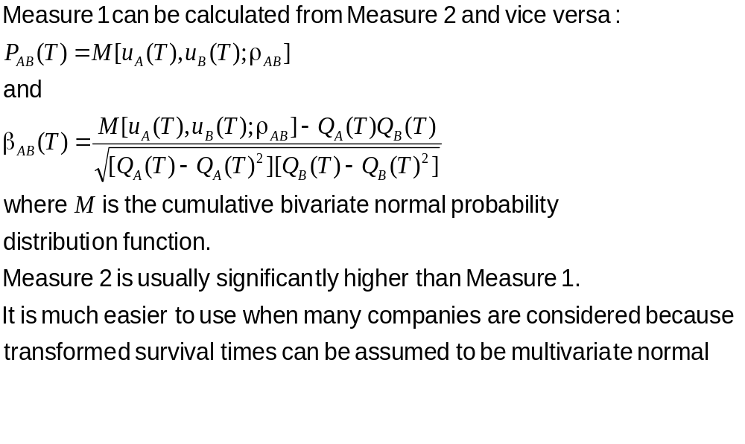
Measure 1 vs Measure 2

Slide 62
Modeling Default Correlations
Two alternatives models of default correlation are:
Structural model approach
Reduced form approach

Slide 63
Market Risk

Slide 64
Market Risk
Two broad types- directional risk and relative value risk. It can be differentiated into two related risks- Price risk and liquidity risk.
Two broad type of measurements
  scenario analysis
  statistical analysis
Notes:
A trader intentionally takes relative value risk when he expects the relative value of two market factors to change in a particular direction (I.e. the relative difference in value will get either smaller or larger.
Price risk is the risk of decrease in the market value of a portfolio. Liquidity risk refers to the risk of being unable to transact a desired volume of contracts at the current market price. It would happen if the size of transaction is materially large.

Slide 65
Scenario Analysis
A scenario analysis measures the change in market value that would result if market factors were changed from their current levels, in a particular specified way. No assumption about probability of changes is made.
A Stress Test is a measurement of the change in the market value of a portfolio that would occur for a specified unusually large change in a set of market factors.

Slide 66
Value at Risk
A single number that summarizes the likely loss in value of a portfolio over a given time horizon with specified probability
C-VaR- Expected loss conditional on that the change in value is in the left tail of the distribution of the change.
Three approaches
  Historical simulation
  Model-building approach
  Monte-Carlo simulation

Slide 67
Historical Simulation
Identify market variables that determine the portfolio value
Collect data on movements in these variables for a reasonable number of past days.
Build scenarios that mimic changes over the past period
For each scenario calculate the change in value of the portfolio over the specified time horizon
From this empirical distribution of value changes calculate VaR.

Slide 68
Model Building Approach
Consider a portfolio of n-assets
Calculate mean and standard deviation of change in the value of portfolio for one day.
Assume normality
Calculate VaR.

Slide 69
Monte Carlo simulation
Calculate the value the portfolio today
Draw samples from the probability distribution of changes of the market variables
Using the sampled changes calculate the new portfolio value and its change
From the simulated probability distribution of changes in portfolio value calculate VaR.

Slide 70
Pitfalls- Normal distribution based VaR
Normality assumption may not be valid for tail part of the distribution
VaR of a portfolio is not less than weighted sum of VaR of individual assets ( not sub-additive). It is not a coherent measure of Risk.
Expected shortfall conditional on the fact that loss is more than VaR is a sub-additive measure of risk.

Slide 71
VaR
VaR is a statistical measurement of price risk.
VaR assumes a static portfolio. It does not take into account
  The structural change in the portfolio that would contractually occur during the period.
  Dynamic hedging of the portfolio
VaR calculation has two basic components
  simulation of changes in market rates
  calculation of resultant changes in the portfolio value.

Slide 72
VaR (Value-at-Risk) is a measure of the risk in a portfolio over a (usually short) period of time.
It is usually quoted in terms of a time horizon, and a confidence level.
For example, the 10 day 95% VaR is the size of loss X that will not happen 95% of the time over the next 10 days.
Value-at-Risk
X
95%
5%
(Profit/Loss Distribution)

Slide 73
Standard Value-at-Risk Levels:
Two standard VaR levels are 95% and 99%.
When dealing with Gaussians, we have:
95% is 1.645 standard deviations from the mean
99% is 2.33 standard deviations from the mean
99%
95%
2.33σ
1.645σ
mean

Slide 74
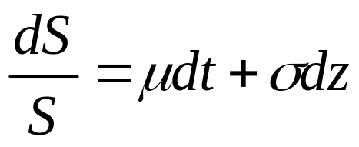


Standard Value at Risk Assumptions:
1) The percentage change (return) of assets is Gaussian:
This comes from:
or
So approximately:
which is normal

Slide 75



Standard Value at Risk Assumptions:
2) The mean return μ is zero:
This comes from an order argument on:
The mean is of order Δt.
The standard deviation is of order square root of t.
Time is measured in years, so the change in time is usually very small. Hence the mean is negligible.

Slide 76
VaR and Regulatory Capital
Regulators require banks to keep capital for market risk equal to the average of VaR estimates for past 60 trading days using X=99 and N=10, times a multiplication factor.
(Usually the multiplication factor equals 3)

Slide 77
Advantages of VaR
It captures an important aspect of risk
in a single number
It is easy to understand
It asks the simple question: “How bad can things get?”

Slide 78
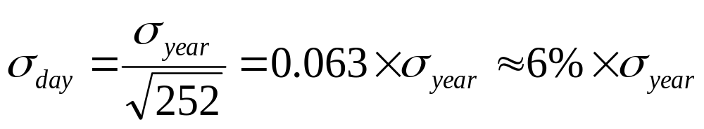
Daily Volatilities
In option pricing we express volatility as volatility per year
In VaR calculations we express volatility as volatility per day

Slide 79
Daily Volatility continued
Strictly speaking we should define σ_{day} as the standard deviation of the continuously compounded return in one day
In practice we assume that it is the standard deviation of the proportional change in one day

Slide 80
IBM Example
We have a position worth $10 million in IBM shares
The volatility of IBM is 2% per day (about 32% per year)
We use N=10 and X=99

Slide 81

IBM Example continued
The standard deviation of the change in the portfolio in 1 day is $200,000
The standard deviation of the change in 10 days is

Slide 82
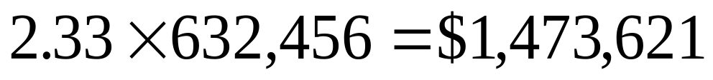
IBM Example continued
We assume that the expected change in the value of the portfolio is zero (This is OK for short time periods)
We assume that the change in the value of the portfolio is normally distributed
Since N(0.01)=-2.33, (i.e. Pr{Z<-2.33}=0.01)
the VaR is

Slide 83
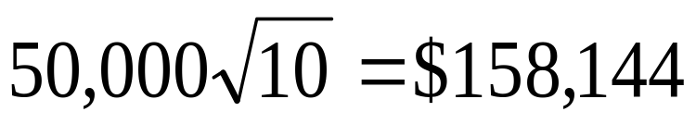
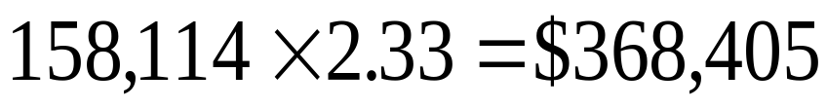
AT&T Example
Consider a position of $5 million in AT&T
The daily volatility of AT&T is 1% (approx 16% per year)
The S.D per 10 days is
The VaR is

Slide 84
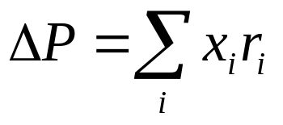


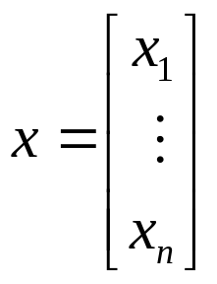
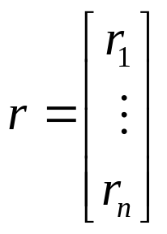

The change in the value of a portfolio:
Let x_{i} be the dollar amount invested in asset i, and let r_{i} be the return on asset i over the given period of time.
Then the change in the value of a portfolio is:
But, each r_{i} is Gaussian by assumption:
Hence, ΔP is Gaussian.
where

Slide 85

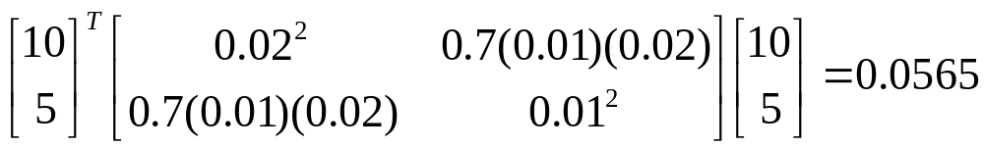
Example:
Consider a portfolio of:
$10 million of IBM
$5 million of AT&T
Returns of IBM and AT&T have bivariate normal distribution with correlation of 0.7.
Volatilities of daily returns are 2% for IBM and 1% for AT&T.
Then
has daily variance:

Slide 86


Example:
Then
has daily variance:
Now, compute the 10 day 95% and 99% VaR:
The variance for 10 days is 10 times the variance for a day:
Since ΔP is Gaussian,
95% VaR = (1.645)0.7516= 1.24 million
99% VaR = (2.33)0.7516 = 1.75 million

Slide 87
VaR Measurement Steps based on EVT
Divide total time period into m blocks of equal size
Compute n daily losses for each block
Calculate maximum losses for each block
Estimate parameters of the Asymptotic distribution of Maximal loss
Choose the value of the probability of a maximal loss exceeding VaR
Compute the VaR

Slide 88
Credit Risk Mitigation

Slide 89
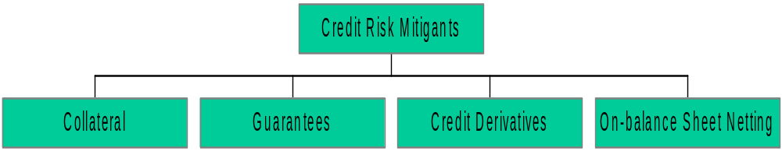
Credit Risk Mitigation
Recognition of wider range of mitigants
Subject to meeting minimum requirements
Applies to both Standardized and IRB Approaches

Slide 90
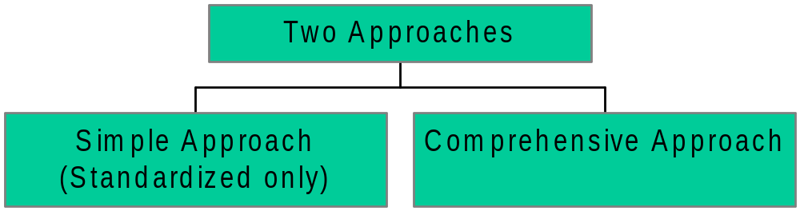
Collateral

Slide 91
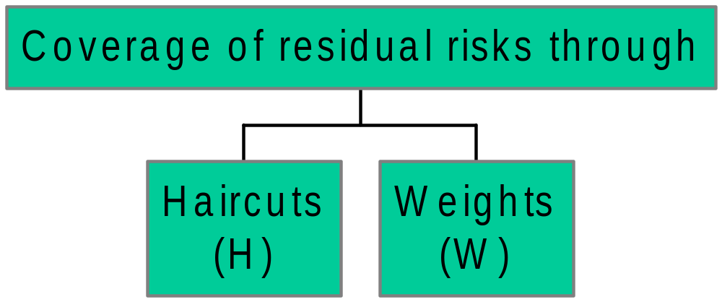
Collateral
Comprehensive Approach

Slide 92
Collateral
Comprehensive Approach
H - should reflect the volatility of the collateral
w - should reflect legal uncertainty and other residual risks.
  Represents a floor for capital requirements

Slide 93
Collateral Example
Rs1,000 loan to BBB rated corporate
Rs. 800 collateralised by bond
issued by AAA rated bank
Residual maturity of both: 2 years

Slide 94
Collateral Example
Simple Approach
Collateralized claims receive the risk weight applicable to the collateral instrument, subject to a floor of 20%
Example: Rs1,000 – Rs.800 = Rs.200
Rs.200 x 100% = Rs.200
Rs.800 x 20% = Rs.160
Risk Weighted Assets: Rs.200+Rs.160 = Rs.360

Slide 95
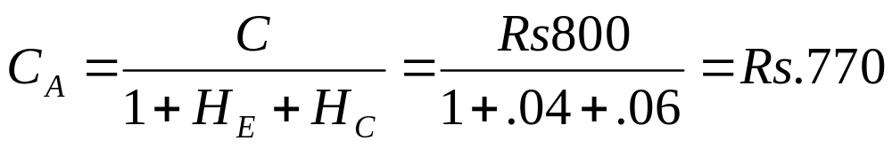
Collateral Example Comprehensive Approach
C = Current value of the collateral received (e.g. Rs.800)
H_{E} = Haircut appropriate to the exposure (e.g.= 6%)
H_{C} = Haircut appropriate for the collateral received (e.g.= 4%)
C_{A} = Adjusted value of the collateral (e.g. Rs.770)

Slide 96
Collateral Example Comprehensive Approach
Calculation of risk weighted assets based on following formula:
r* x E = r x [E-(1-w) x C_{A}]

Slide 97
Collateral Example Comprehensive Approach
r* = Risk weight of the position taking into account the risk reduction (e.g. 34.5%)
w¹ = 0.15
r = Risk weight of uncollateralized exposure
(e.g. 100%)
E = Value of the uncollateralized exposure
(e.g. Rs1000)
Risk Weighted Assets
34.5% x Rs.1,000 = 100% x [Rs1,000 - (1-0.15) x Rs.770] = Rs.345
Note: 1 Discussions ongoing with BIS re double counting of w factor with Operational Risk

Slide 98
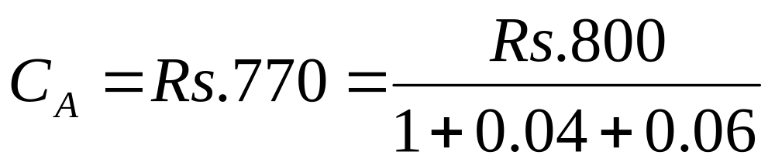
Collateral Example Comprehensive Approach
Risk Weighted Assets
34.5% x Rs.1,000 = 100% x [Rs.1,000 - (1-0.15) x Rs.770] = Rs.345
Note: comprehensive Approach saves

Slide 99
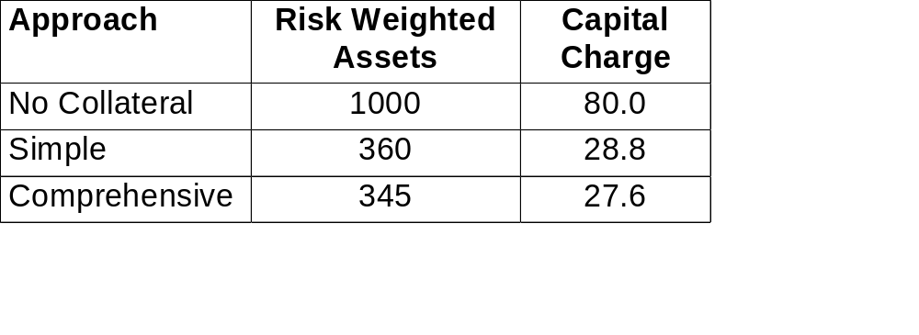
Collateral Example
Simple and Comprehensive Approaches

Slide 100
Operational Risk
IX.

Slide 101
Operational Risk
Definition:
  Risk of direct or indirect loss resulting from inadequate or failed internal processes, people and systems of external events
  Excludes “Business Risk” and “Strategic Risk”
Spectrum of approaches
  Basic indicator - based on a single indicator
  Standardized approach - divides banks’ activities into a number of standardized industry business lines
  Internal measurement approach
Approximately 20% current capital charge

Slide 102
CIBC Operational Risk Losses Types
1. Legal Liability:
    inludes client, employee and other third party law suits
2 . Regulatory, Compliance and Taxation Penalties:
    fines, or the cost of any other penalties, such as license revocations and associated costs - excludes lost / forgone revenue.
3 . Loss of or Damage to Assets:
    reduction in value of the firm’s non-financial asset and property
4 . Client Restitution:
    includes restitution payments (principal and/or interest) or other compensation to clients.
5 . Theft, Fraud and Unauthorized Activities:
includes rogue trading
6. Transaction Processing Risk:
includes failed or late settlement, wrong amount or wrong counterparty
Notes:
Value - book not economic

Slide 103
Operational Risk- Measurement
Step1- Input- assessment of all significant operational risks
  Audit reports
  Regulatory reports
  Management reports
Step2-Risk assessment framework
  Risk categories- internal dependencies-people, process and technology- and external dependencies
  Connectivity and interdependence
  Change,complexity,complacency
  Net likelihood assessment
  Severity assessment
  Combining likelihood and severity into an overall risk assessment
  Defining cause and effect
  Sample risk assessment report

Slide 104
Operational Risk- Measurement
Step3-Review and validation
Step4-output

Slide 105
The Regulatory Approach:Four Increasingly Risk Sensitive Approaches
Risk Based/ less Regulatory Capital:
Basic Indicator
Standardized
Internal Measurement Approach
Loss Distribution
Standardized
Approach
Internal Measurement Approach
Loss Distribution
Approach
Bank
Bank
Risk Type 1
Risk Type 6
Bank
Rate
β₁
Base
LOB1
LOB1
Rate 1
Rate₁
EI₁
EI₁
Base
Expected
Loss
LOB2
β₂
LOB2
Rate 2
Rate₂
Severe
Unexpected
Loss
Catastrophic
Unexpected
Loss
EI₂
EI₂
Base
Probability
LOB3
LOB3
Base
Base
Loss
LOBn
β_{N}
LOBn
Rate_{N}
Rate_{N}
EI_{N}
EI_{N}
Base
Rate of progression between stages based on necessity and capability

Slide 106
Operational Risk -
Basic Indicator Approach
Capital requirement = α% of gross income
Gross income = Net interest income
+
Net non-interest income
Note: α supplied by BIS (currently α = 30%)

Slide 107
Proposed Operational Risk Capital Requirements
Reduced from 20% to 12% of a Bank’s Total Regulatory Capital Requirement (November, 2001)
Based on a Bank’s Choice of the:
(a) Basic Indicator Approach which levies a single operational risk charge for the entire bank
or
(b) Standardized Approach which divides a bank’s eight lines of business, each with its own operational risk charge
or
(c) Advanced Management Approach which uses the bank’s own internal models of operational risk measurement to assess a capital requirement

Slide 108
Operational Risk -
Standardized Approach
Banks’ activities are divided into standardized business lines.
Within each business line:
  specific indicator reflecting size of activity in that area
  Capital charge_{i} = β_{i} x exposure indicator_{i}
Overall capital requirement =
sum of requirements for each business line

Slide 109
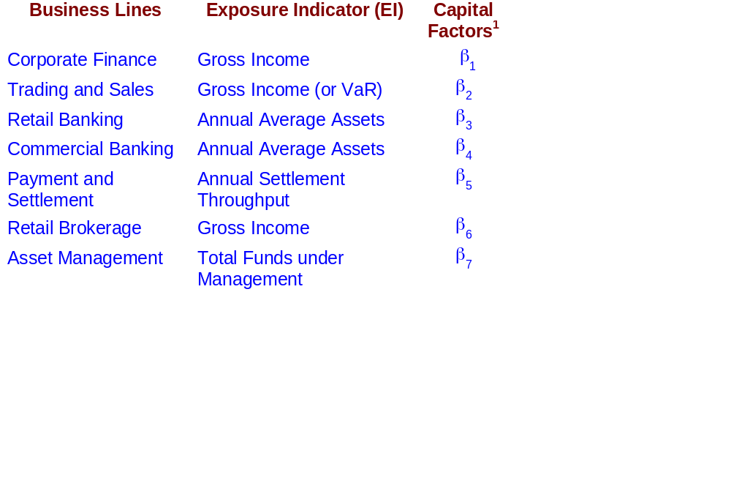
Operational Risk -
Standardized Approach
Example
Note: ¹ Definition of exposure indicator and B_{i} will be supplied by BIS

Slide 110
Operational Risk -
Internal Measurement Approach
Based on the same business lines as standardized approach
Supervisor specifies an exposure indicator (EI)
Bank measures, based on internal loss data,
  Parameter representing probability of loss event (PE)
  Parameter representing loss given that event (LGE)
Supervisor supplies a factor (gamma) for each business line

Slide 111
The Internal Measurement Approach
For a line of business and loss type
Op Risk Capital (OpVaR) = EI_{LOB} x PE_{LOB} x LGE_{LOB} x γ_{industry} x RPI_{LOB}
LR _{firm}
EI = Exposure Index - e.g. no of transactions * average value of transaction
PE = Expected Probability of an operational risk event
        (number of loss events / number of transactions)
LGE = Average Loss Rate per event - average loss/ average value of transaction
LR = Loss Rate ( PE x LGE)
γ= Factor to convert the expected loss to unexpected loss
RPI = Adjusts for the non-linear relationship between EI and OpVar
(RPI = Risk Profile Index)
Rate

Slide 112
The Components of OP VaR e.g. VISA Per $100 transaction
20%
70%
Expected
Loss
16%
60%
Severe
Unexpected
Loss
12%
+
50%
=
Catastrophic
Unexpected
Loss
8%
40%
Probability
4%
30%
1.3
9
0%
Loss
70
100
9
52
Number of Unauthorized Transaction
Loss per $1 00 Fraudulent Transaction
Loss per $1 00Transaction
The Probability Distribution
The Severity
Distribution
The Loss
Distribution
Eg; on average 1.3 transaction per
1,000 (PE) are fraudulent
Note: worst case
is 9
Eg; on average 70% (LGE) of the value of the transaction have to be written off
Note: worst case
is 100
Eg; on average 9 cents per $100 of transaction (LR)
Note: worst case
is 52

Slide 113
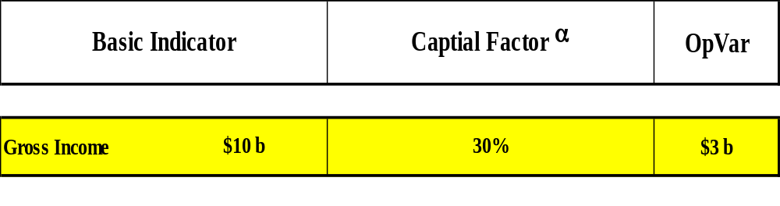
Example - Basic Indicator Approach

Slide 114
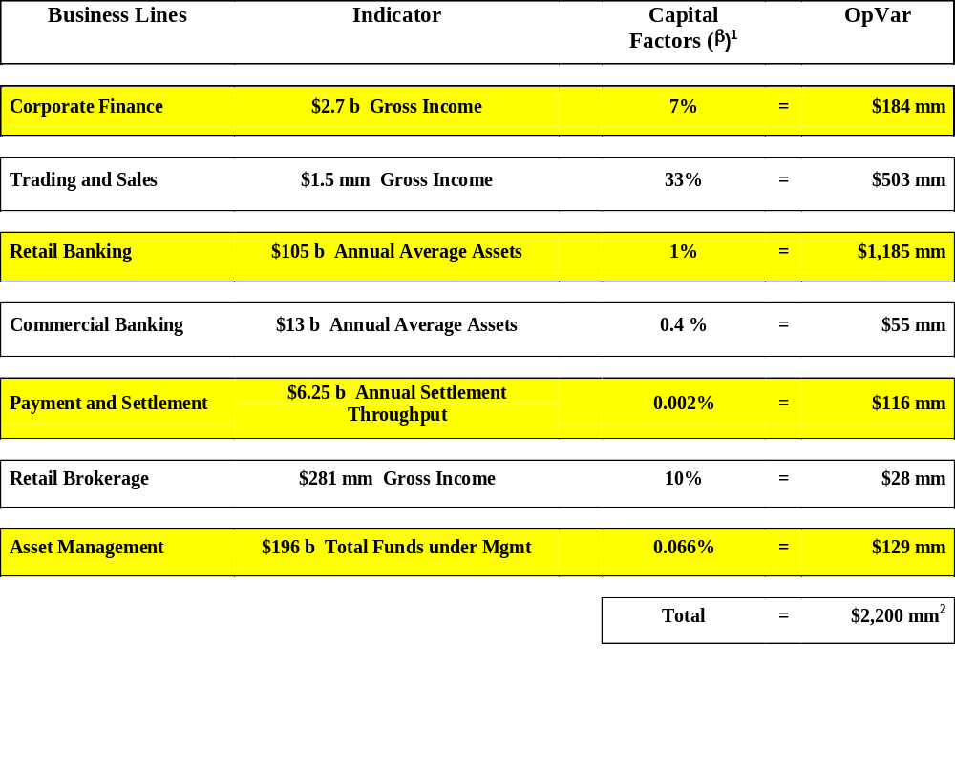
Example - Standardized Approach
Note:
1. β’s not yet established by BIS
2. Total across businesses does not allow for diversification effect

Slide 115
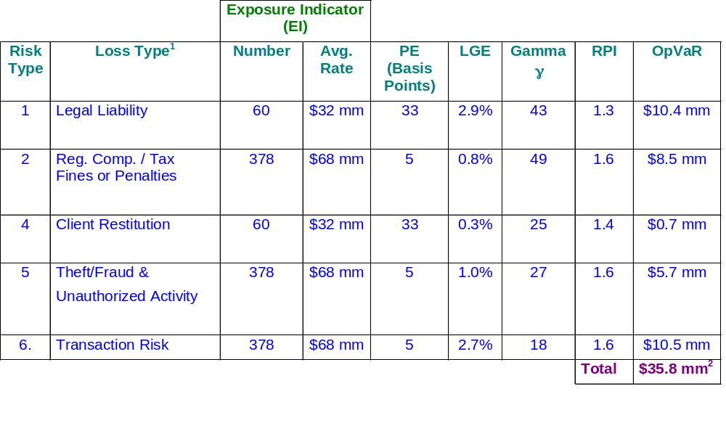
Example - Internal Measurement Approach
Business Line (LOB): Credit Derivatives
Note:
1. Loss on damage to assets not applicable to this LOB
2. Assume full benefit of diversification within a LOB

Slide 116
Implementation Roadmap

Slide 117
Seven Steps
Gap Analysis
Detailed project plan
Information Management Infrastructure- creation of Risk Warehouse
Build the calculation engine and related analytics
Build the Internal Rating System
Test and Validate the Model
Get Regulator’s Approval

Slide 118
References
Options,Futures, and Other Derivatives (5th Edition) – Hull, John. Prentice Hall
Risk Management- Crouchy Michel, Galai Dan and Mark Robert. McGraw Hill

